Slide 1
SharePoint 2013 Workflow
Name
Title
Company

Slide 2
Agenda
Introduction to Workflow Architecture Platform
SharePoint Workflow Improvements
Developing Workflows
SharePoint Designer
Visual Studio
Dynamic Values
Workflow Powered SharePoint Apps

Slide 3
Introduction

Slide 4
Workflow in SharePoint 2010
SharePoint 2010 hosted the Workflow Foundation (WF) workflow runtime
Tightly coupled workflow to SharePoint 2010
Workflow data kept in SharePoint content databases
Challenges:
Designed for on-premise deployments (scale)
In SharePoint, extending WF meant you had to be a box admin
Analytics on current/previous workflow instances hard to acquire
Executed in the context of SharePoint as super user
Notes:
SharePoint 2010 leveraged Workflow Foundation (WF) found in the .NET Framework 3.5 SP1. There wasn’t much difference in SharePoint 2010’s workflow story from SharePoint 2007 from an architectural perspective as SharePoint 2007 introduced workflow to the SharePoint platform via .NET Framework 3.0. The biggest improvements around workflow in SharePoint 2010 included:
Site-based workflows: Workflows that run within the context of an SPWeb (previously they could only run within the context of an SPListItem)
Power User Tooling Improvements:
Workflows could be modeled using Visio 2010 and exported/imported to SharePoint Designer 2010.
Ability to create “Reusable Workflows” or those that are tied to content types.
Ability to import reusable workflows into Visual Studio 2010 coded workflows.
Workflow Events: Override able events developers can handle to run custom processes.
Workflows built for SharePoint were tightly coupled by SharePoint and ran at a very low level & were designed primarily for on-premise deployments.
This meant that coded workflows could not run within the sandbox or in a hosted environment.
All workflow data was also retained within the site collection’s content database where the workflow ran.

Slide 5
Workflow in SharePoint 2013
Workflow now treated as a service in SharePoint 2013
Moved to Windows Azure Workflow
No longer runs in the content farm
No longer runs on SharePoint WFE / App servers
Harnesses the latest workflow technology from Microsoft
Windows Azure Workflow available for on-prem deployments
Improves stability, scalability & transparency
Notes:
SharePoint 2013 takes a very different approach to workflow. Existing SharePoint 2010 workflows will still run using the same legacy SharePoint 2010 / .NET Framework 3.5 architecture and developers/users are free to continue creating workflows using this approach although it is not recommended.
SharePoint 2013 workflows are based on Windows Workflow Foundation 4.0 (WF), which has been substantially redesigned from earlier versions. WF, in turn, is built on the messaging functionality provided by WCF. The workflow story in SharePoint 2013 now treats workflow as a separate service and leverages Windows Azure Workflow which includes the WF included in .NET Framework 4.0. The workflow service provided by Windows Azure Workflow is decoupled from SharePoint and no longer runs in the content farm, rather it runs on it’s own servers. Windows Azure Workflow also leverages the latest and greatest advancements in workflow capabilities, performance and scalability from Microsoft.
This new architecture is available both in the on-premise model using Windows Azure Workflow as well as in a hosted model. By moving to this new architecture, SharePoint benefits from improvements in stability & scalability in the workflow platform. In addition Windows Azure Workflow is much more transparent where developers can use a service-based API to gain insight into metrics and analytics of WF.
Windows Azure Workflow is very much a customer and leverages the new SharePoint App Model architecture in that workflow (like apps) are treated as a “service”. SharePoint instructs Windows Azure Workflow to execute a workflow and the two products communicate with each other over a service model infrastructure (WCF).

Slide 6
SharePoint 2013 & Windows Azure Workflow
SharePoint 2013 has improved CSOM & REST API’s for workflow
Workflows communicate w/ SharePoint via core App Model technologies
CSOM / REST
OAuth
Types of workflows in SharePoint 2013
SharePoint 2010 Workflow:
Workflow Foundation v3.5 hosted by SharePoint
SharePoint 2013 Workflow:
Windows Azure Workflow: Hosted / On-Premise WF v4
Notes:
SharePoint 2013 also has new CSOM and REST APIs exposing running workflows without having to go directly to the Windows Azure Workflow instances. SharePoint communicates with the workflows in Windows Azure Workflow via standard protocols (WCF Services over port 80 (HTTP) / 443 (HTTPS). These workflows are primarily declarative but can also be extended with custom code similar to how developers can create custom activities/actions in SharePoint 2010 workflows for SharePoint Designer 2010.
Customers creating new workflows in SharePoint 2013 are presented with two options in SharePoint Designer 2013:
SharePoint 2010 Workflow: Workflows based on the same SharePoint 2010 model using .NET Framework 3.5 SP1 WF. These execute the same way they did in SharePoint 2010 (they run within the same SharePoint processes) and cannot leverage any of the improvements outlined in the remainder of this module.
SharePoint 2013 Workflow: This option is available when SharePoint 2013 is connected to a configured instance of Windows Azure Workflow. These workflows execute within Windows Azure Workflow and not within the SharePoint process. They can leverage all the improvements outlined in the remainder of this module.

Slide 7
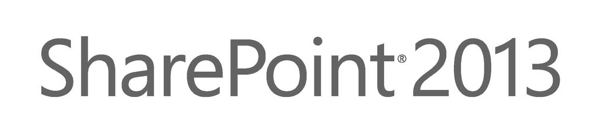



Workflow Manager in SharePoint 2013
Azure
Access Control
Solutions
Content
WF3
Host
OAuth2
Visual Studio
Azure Workflow
Apps
Events
SharePoint OM
Azure
Workflow
SharePoint Designer
Workflow Services
Manager
REST Calls
Deployment
Messaging
Azure
ServiceBus
Instances
Interop
Events
Azure Workflow Service Application Proxy

Slide 8
SharePoint Workflow Improvements
Introducing “Stages”
Provides support for repeating & skipping workflow steps
Declarative workflows have loops
Loop # times / with condition / with expression
Declarative workflows can call REST/SOAP services
Notes:
Stages: In the past, declarative workflows have been strictly serial: They start at the beginning and progress to the end. Now, SharePoint Designer 2013 introduces an important new building block—the stage. Stages are a top-level container that you use to group together conditions, actions, or steps. The conditions, actions, or steps in one stage are processed in the listed order before the workflow transitions to the next specified stage. But here’s the important part: The transition means that the next stage can be any stage in the workflow—not necessarily the next stage serially.
Stages, not steps, are the new top-level containers.
Stages cannot be nested in any other building block; a stage must be at the top level.
Only stages can have Go To actions, and the target of a Go To action must be another stage.
Steps can be nested in stages and other steps.
A stage can be connected only to another stage. (In the visual workflow designer only, a stage can also be connected to a condition shape.)
Loops: SharePoint Designer 2013 now provides looping. A loop is a container that you can use to group conditions and actions that you want the workflow to process repeatedly.
Calling Services: You can now call SOAP and REST web services from within declarative workflows. Data returned by those Web services is stored in workflow variables and can then be used by the workflow in any number of scenarios. These actions provide tremendous flexibility in integrating data external to SharePoint into your workflows. The recommended approach to embedding custom logic implemented with custom code in SharePoint 2013 workflows is to create a custom SOAP / REST service and use the new service actions to all can consume these from your declarative workflow.

Slide 9
SharePoint Workflow Improvements
SharePoint 2010 required developers when:
Call SharePoint API
Connect & query databases
Consume feeds (ATOM / REST)
Call Web Services / REST
SharePoint 2013 enables workflow authors to do all this declaratively
Notes:
Additional improvements to workflow in SharePoint 2013 workflow address issues when workflow authors were required to engage developers to build something due to limitations with SharePoint Designer. For example, developers had to either build custom activities and wrap them in actions for use in SharePoint Designer workflows (or build the workflow wholly in Visual Studio) when they needed to work directly with the SharePoint API, connect & query custom databases, consume RSS/ATOM/REST feeds or interact with Web services. Further, none of these things were possible in a hosted environment as they could only be done from fully-trusted farm solutions.
The authoring tools in SharePoint 2013, including both SharePoint Designer & Visual Studio, support building not only declarative workflows, but also using activities that can call custom Web services. The recommended approach when custom code is needed is to deploy the custom code as a Web service (hosted outside of SharePoint) and call that service with the provided actions and activities.

Slide 10
Creating custom workflows

Slide 11
Creating Custom Workflows
Can create WF 3.5 or WF 4 workflows
For WF 4, Azure Workflow required
For WF 3.5, see Workflow Interop Bridge…
Focus is around declarative workflows
Push custom code logic to Web services
Programmatic workflows still possible, but only in Windows Azure Workflow
Workflow tools: SharePoint Designer & Visual Studio
Notes:
SharePoint 2013 supports creating workflows based on both Workflow Foundation (WF) v3.5 and WF v4.0. The recommended approach is to create WF for SharePoint 2013 using WF v4. In order to this SharePoint must be connected to an installed and configured Windows Azure Workflow. If this step has not been completed you will only be able to create workflows using the WF v3.5 engine which is hosted by SharePoint.
You can leverage your existing workflow investments such as workflows created in the previous version of SharePoint that are based on WF v3.5 in your SharePoint 2013 deployment as well as in new WF v4 based workflows. This is done via the new Workflow Interop Bridge (covered later in this module).
The focus in SharePoint 2013 workflows is to build workflows declaratively. This is different from previous versions of SharePoint where one tool (SharePoint Designer) was used to create declarative workflows while the Visual Studio could only create programmatic workflows. Programmatic workflows are still possible, but they are not SharePoint workflows, they are workflows that run within on the context of Windows Azure Workflow and can call SharePoint using the REST and CSOM APIs provided they have been granted access via OAuth2.

Slide 12
SharePoint Designer 2013
Improved visual designer
Integrated the Visio designer into SharePoint
Can switch between visual designer & sentence-style
Editable properties helper
Stages & Loops
Calling REST Web Services
Designer supports cut / copy / paste / undo / redo / select-all
Improved email editor (rich formatting)
Notes:
SharePoint Designer 2013 now provides a visual workflow designer. The previous version, SharePoint Designer 2010, offered integration with Microsoft Visio 2010, so that you could design workflows visually in Visio and then import them into SharePoint Designer. Now, you can visually design your workflows by dragging, dropping, and connecting shapes directly within SharePoint Designer 2013. You can set all the properties of a workflow action in the new visual workflow designer—just select the shape and then click the action tag. Also, if you click Properties on the action tag, the property grids for conditions and actions appear in the visual designer, just as they do in the declarative workflow designer.

Slide 13
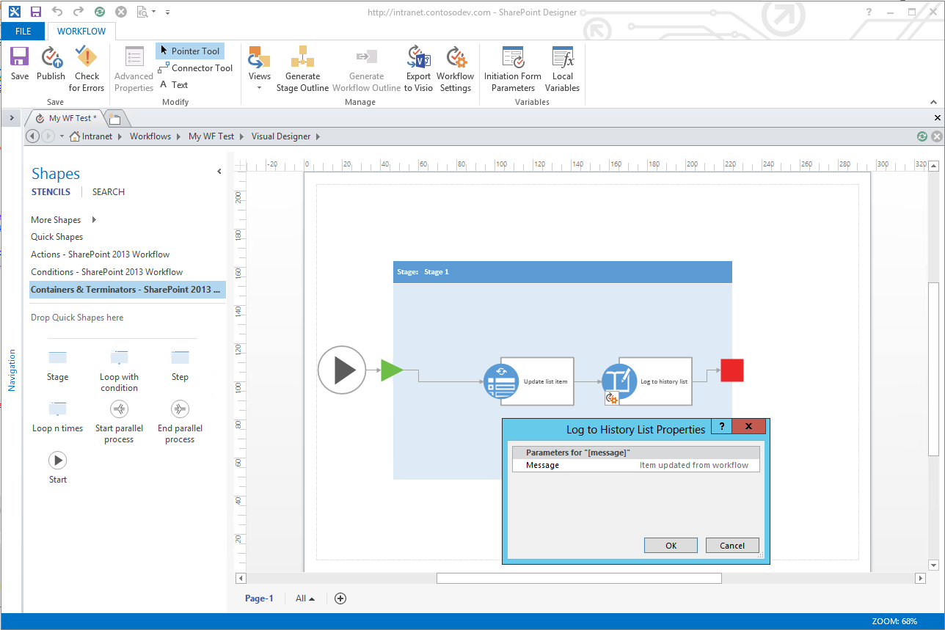
SharePoint Designer – Visual Designer
Notes:
In addition to the existing Test-Based Designer, SharePoint Designer has been improved to include a visual designer for authoring and customizing workflow, similar to how Visio allowed you to create workflows in previous versions of SharePoint. This new designer in SharePoint Designer, available when Visio is installed, allows you to not only customize the workflow actions & stages but you can modify the properties of the actions directly in the Visual Designer.

Slide 14
My First SharePoint 2013 Workflow
demo

Slide 15
SharePoint Designer Workflow Stages
Each stage has an entry point & gate
Gate: conditional transition point where workflow exits
Underlying core in WF4 flow step in a flowchart
Can contain multiple steps
Mitigates SharePoint Designer loop limitations
Notes:
Microsoft has introduced the concept of stages to workflows in SharePoint 2013. Stages, founded on the flowchart workflow type in WF 4.0, mitigate a lot of the challenges people had creating workflows with SharePoint Designer in previous versions of SharePoint, specifically the loop limitations.
Each stage has an entry point & gate. All workflows start by entering the first stage. At the end of a stage the workflow author dictates the next stage (optionally using a conditional IF statement) the workflow should proceed to. Further, each workflow stage can contain multiple steps and actions within it.

Slide 16
SharePoint Designer - Stages
Workflow
Stage B
Stage A
Start
Gate
Start
Gate
OR ”B”
Action
Conditional coucome
Action
Action
Conditional coucome
Condition
Action
Condition
OR ”C”
Stage C
OR ”A”
Start
Gate
Action
Conditional coucome
Action
Condition
Notes:
This slide shows how one might create a workflow using stages.

Slide 17
Actions, Conditions & Loops
Types of actions:
Core actions
List actions
Conditional actions
Utility actions
Task actions
Project actions (for use with Microsoft Project)
Examples: Send an Email, Call Web Service, Pause Until Date
Conditions enable the workflow to evaluate the outcome of actions & then branch/loop
Notes:
SharePoint 2013 workflows are built using a series of actions that are arranged in stages & steps as well as conditions and loops.
There are multiple types of actions:
Core Actions: Actions for adding comments, adding time to date, calling services, performing calculations, sending emails, etc.
List Actions: Check In/Out items, copy items, updating items, etc.
Conditional Actions: If statements, checking if something was created or modified by a specific person or in a time span, etc.
Utility Actions: String manipulation functions.
Task Actions: Assigning tasks or starting a task process.

Slide 18
Workflow Stages in SharePoint 2013
demo

Slide 19
Workflow Tooling Compared
 | SharePoint Designer | Visual Studio
Reusability | Create reusable WF | Create WF templates
Include in SP App |  | X
Custom Code
Custom Actions | Consume, not create | Yes; underlying activities
Visio Integration | X
Debugging |  | X
Notes:
The two primary tools, SharePoint Designer & Visual Studio, used to create custom workflows in SharePoint 2013 are similar but have some distinct differences from their previous versions:
Reusability: Similar to previous versions, SharePoint Designer can create reusable workflows that can be used multiple times within the same site or exported for deployment to other sites. Visual Studio workflows are created as templates which can be deployed and associated with any list or library.
Deployment: Workflows authored with SharePoint Designer are automatically added to the site or list at design time. These types of workflows cannot be included in an app package using the new SharePoint App Model. Visual Studio based workflows are written as templates that can be included in a new SharePoint App and associated with a list or library.
Custom Code: Neither Visual Studio nor SharePoint Designer can create workflows with custom code. This is a big change from SharePoint 2010 where Visual Studio workflows were based on custom code. However in SharePoint 2013 all workflows are declarative. When you need to use custom code to implement logic in a workflow, you should use either the new activities for calling SOAP/REST Web services (available to SharePoint Designer & Visual Studio) and include the logic in a web service or create a custom activity/action which can be used in either tool.
Custom Actions: Both SharePoint Designer & Visual Studio can consume & use custom actions in authored workflows. However Visual Studio will use the underlying action’s activity and not the action in it’s workflow. Further custom activities/actions can be created using Visual Studio.

Slide 20
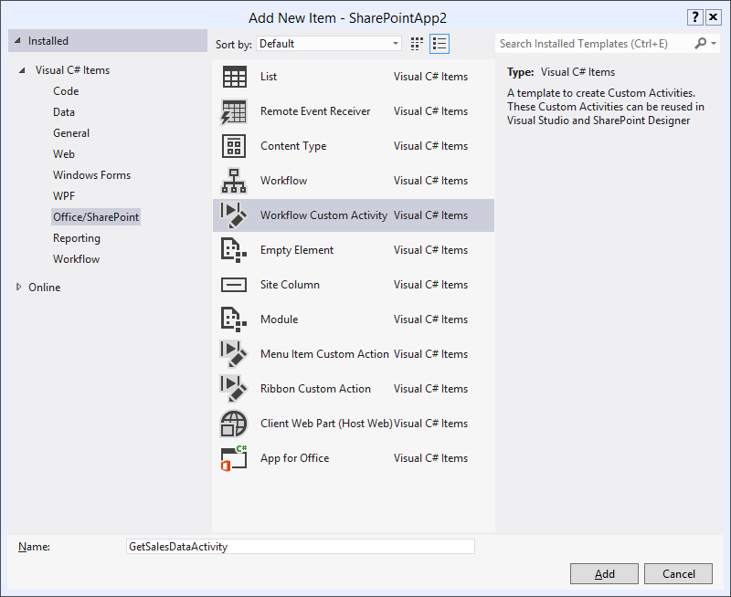
Visual Studio Workflow Tooling
Developers can create custom activities & actions
New VS project item template
SharePoint Designer can use custom actions that map to custom activities
Visual Studio uses the activities
Notes:
Microsoft has improved the workflow tooling in Visual Studio for SharePoint 2013. A new SharePoint project item (SPI) template is now included to assist in creating custom activities and actions for declarative workflows.

Slide 21
Visual Studio: Two Types of Workflow
SharePoint 2010 Workflows:
Create traditional Workflow Foundation v3.5
SharePoint specific activities available to developers
SharePoint 2013 Workflows:
Based on Workflow Foundation v4.0
Two options: on-premise & hosted
Package as *.WSP or *.APP
Notes:
SharePoint Designer is the preferred tool for building workflows in SharePoint 2013. You can still use Visual Studio to build custom workflows and there are one or two things that Visual Studio does offer that isn’t possible in SharePoint Designer.
When creating a workflow in Visual Studio you can select if you want to create a traditional SharePoint 2010 style workflow (which will be based on WF v3.5 and not have any of the new capabilities offered in SharePoint 2013) or a SharePoint 2013 workflow.
SharePoint 2013 workflows are based on WF v4.0 and can be deployed either on-premise or in a hosted environment. Some activities may or may not be available depending on how where the workflow will be deployed (on-prem / hosted). The reason for this is that all SharePoint workflows in SharePoint 2013, even those built using Visual Studio, are declarative, not programmatic like previous versions of Visual Studio.
One big advantage Visual Studio workflows have on SharePoint Designer workflows is that they can be packaged within a SharePoint app for deployment with the app. This can prove a very powerful technique as the workflow could be used as the business logic for the SharePoint-hosted app where the app can initiate & interact with the workflow using the included CSOM & REST APIs.

Slide 22
Declarative vs. Programmatic Workflows
Declarative workflows are recommended
Both supported by SharePoint Designer & Visual Studio
No underlying knowledge of WF API required
New activities for calling Web services should be used when custom code is required
Programmatic / Coded Workflows:
Supported in WF 3.5 (SharePoint 2010 model)
Supported in Windows Azure Workflow
Leverages OAuth & REST / CSOM to talk to SharePoint
Notes:
The recommended approach to creating workflows in SharePoint 2013 is to create declarative workflows. Both Visual Studio and SharePoint Designer support creating declarative workflows. This approach means workflow authors do not have to have an in-depth understanding and familiarity with the WF or SharePoint API to create workflows.
In the cases where custom code is required for business logic, developers should wrap this code within a custom web service and host it somewhere (Azure, IIS, etc.). The workflow activities for calling web services can then be used to interact with these Web services.

Slide 23
Dynamic Values

Slide 24
DynamicValue Type
Enable creating, storing and consuming data structures within workflows declaratively
DynamicValue data can be recursive, such as JSON
Windows Azure Workflow include special activities for working with the DynamicValue type:
BuildDynamicValue | CountDynamicValueItems | GetDynamicValueProperties
ContainsDynamicValueProperty | CreateDynamicValue | GetDynamicValueProperty<T>
CopyDynamicValue | CreateUriFromDynamicValue | ParseDynamicValue
Notes:
A new DynamicValue type enables workflow authors to work with structured data within workflows in a declarative way. DynamicValue data can be recursive and thus, supports JSON responses from OData and REST services. Windows Azure Workflow includes new workflow activities for working with DynamicValues within workflows without having to write any code:
BuildDynamicValue: Builds a DynamicValue instance. It receives a dictionary of paths and values as input and returns the resulting DynamicValue. It uses a multi-assign approach to build the DynamicValue (it accepts multiple paths and values).
ContainsDynamicValueProperty: Returns true if a DynamicValue contains a property represented by the specified path.
CopyDynamicValue: Copies properties from one DynamicValue to another DynamicValue.
CountDynamicValueItems: Returns the count of children in a DynamicValue path.
CreateDynamicValue: Create an instance of a DynamicValue passing only one path and one value (no multi-assign semantics).
GetDynamicValueProperties: Get several properties of an existing DynamicValue. Given a DynamicValue a user can query multiple properties (passing multiple paths) using a single activity.
GetDynamicValueProperty<T>: Get one property of a DynamicValue, where T is one of the types in previously given list.
ParseDynamicValue: Parse a JSON string into a DynamicValue.

Slide 25
DynamicValue Example
Request:
http://foo.com/odata/v2/Products/Titles?Top=2
accept: application/json
Response:
{“d”:
{“results”:
{"ID":"123", "Name":"Phone", "Price":"74.99"},
{"ID":"456", "Name":"Laptop", "Price":"1999.99"}
}
}
DynamicValue Path: d/results(1)/Name
Results: Laptop
Notes:
In this example a request is made to a fake OData service that returns a list of products. By passing in a valid OData URL and including the HTTP Header “accept: application/json”, the service will respond with the top two products in the company catalog in JSON format.
The activities provided in SharePoint 2013 and Windows Azure Workflow, a developer could author a workflow with Visual Studio that does the following:
Issue an HTTP GET (activity=HttpGet) to obtain a JSON result & store the result in a local field jsonResponse
Extract a value from the JSON result jsonResponse (activity=GetDynamicValueProperty<T>) and using the path d/results(1)/Name to get the name of the second product returned (Laptop), storing it in a local field productName
Use the productName field elsewhere in the workflow

Slide 26
Workflows in Visual Studio & Working with DynamicValue
demo

Slide 27
Workflow Interop Bridge
Enables SharePoint 2010 workflows to work in 2013
Execution engine hosted in SharePoint 2013
Interop bridge:
Negotiates between two execution engines (SP2010 & SP2013)
Delegates SP2010 workflows to SharePoint from WAWS
Invoke SP2010 workflow action from WAWS with InvokeSharePointWorkflow action
Notes:
Existing SharePoint 2010 workflows will continue to run within the context of SharePoint within SharePoint 2013 and cannot leverage new additions to the workflow story in SharePoint 2013. However at times a SharePoint 2010 workflow may need to communicate with a SharePoint 2013 workflow. The Workflow Interop Bridge is a tool to connect SharePoint Workflow to Windows Azure Workflow workflow. The bridge exists to allow customers to reuse existing workflow assets available in SharePoint and provide a smooth transition path to Windows Azure Workflow. It allows Windows Azure Workflow workflows to delegate part of the process to SharePoint, enabling reuse of existing workflow assets that may not be available in Windows Azure Workflow. It removes the complexity of creating workflows that span the SharePoint workflow host and the Windows Azure Workflow workflow host. Customers will not have to write any service gateways, solve distributed security models, and cross-product integration challenges.
Essentially, the Interop Bridge allows SharePoint workflows based on Workflow Foundation 3 to run. Windows Azure Workflow simply calls back into SharePoint which hosts the Workflow Foundation 3 runtime and receives a message when the process has completed.

Slide 28



Workflow Interop Bridge
SharePoint
Workflow Manager
SharePoint Wofklow Engine
Workflow Service
Messaging Layer
2
1
InvokeSharePointWorkflow
OnWorkflowActivated
Control Endpoint
Start request
OnWorkflowActivated
Event Publisher
4
Completed notification
5
3
Workflow Events
Notes:
The message flow documented on this slide is kicked off when the Windows Azure Workflow workflow encounters a branch of the workflow that calls the interop bridge by invoking the activity InvokeSharePointWorkflow. From there, the following happens:
The InvokeSharePointWorkflow activity tells the Workflow 3 engine in SharePoint to start (by calling a Web service). This message includes the workflow instance ID which acts as a correlation ID when SharePoint sends a completed message back to Windows Azure Workflow (#4).
The SharePoint workflow Web service authorizes the request & then starts the workflow.
When finished, workflow events are used to publish a message through the SharePoint event publisher. This message includes the workflow instance ID.
The SharePoint event publisher notifies Windows Azure Workflow using the same pipeline that is used to notify Windows Azure Workflow of list events (for instance: item updated/added).
Windows Azure Workflow dispatches a Completed message to the instance within Windows Azure Workflow using the instance ID as the correlation ID.

Slide 29
Workflows and SP Apps

Slide 30
Workflow Powered SharePoint Apps
Use workflow in SharePoint 2013 to be the middle tier business logic for apps
Apps for Office
Apps for SharePoint
Execution handled by Windows Azure Workflow
Called via REST API
Low barrier to entry
Inherently multi-tenant & isolated
Notes:
The new workflow model, using Azure Workflow and SharePoint apps, enables a brand new kind of solution. Workflows can now be used as the middle-tier host for business logic for SharePoint apps where the app is a SharePoint hosted app. This technique is useful when you want to secure or protect the intellectual property of your business logic. The apps can then initiate and interact with the workflow using the CSOM & the REST API’s, as well as new APIs for Windows Azure Workflow that are accessible via services as well.
In addition to SharePoint hosted apps, this technique could also be used by the new Office 2013 extensibility capability, apps for Office, or any other web-based application.

Slide 31
Use Workflows in SP Apps for
Modeling the way people do their work
Example: Content creation, review, and publishing app
Automating-monitoring-improving a business process
Example: Helpdesk app
Connecting to other enterprise systems
Example: Integrate Dynamics CRM sales leads and SharePoint documents with workflow
Other middle tier operations
Example: Look up and update sales tax on a product in a product catalog

Slide 32
Summary
Overview of Workflow Architecture Platform
SharePoint Workflow Improvements
Developing Workflows with SharePoint Designer
Developing Workflows with Visual Studio
Dynamic Values
Workflow Powered SharePoint Apps

Slide 33
Q&A

Slide 34

© 2012 Microsoft Corporation. All rights reserved. Microsoft, Windows, Windows Vista and other product names are or may be registered trademarks and/or trademarks in the U.S. and/or other countries.
The information herein is for informational purposes only and represents the current view of Microsoft Corporation as of the date of this presentation. Because Microsoft must respond to changing market conditions, it should not be interpreted to be a commitment on the part of Microsoft, and Microsoft cannot guarantee the accuracy of any information provided after the date of this presentation. MICROSOFT MAKES NO WARRANTIES, EXPRESS, IMPLIED OR STATUTORY, AS TO THE INFORMATION IN THIS PRESENTATION.

